Slide 1
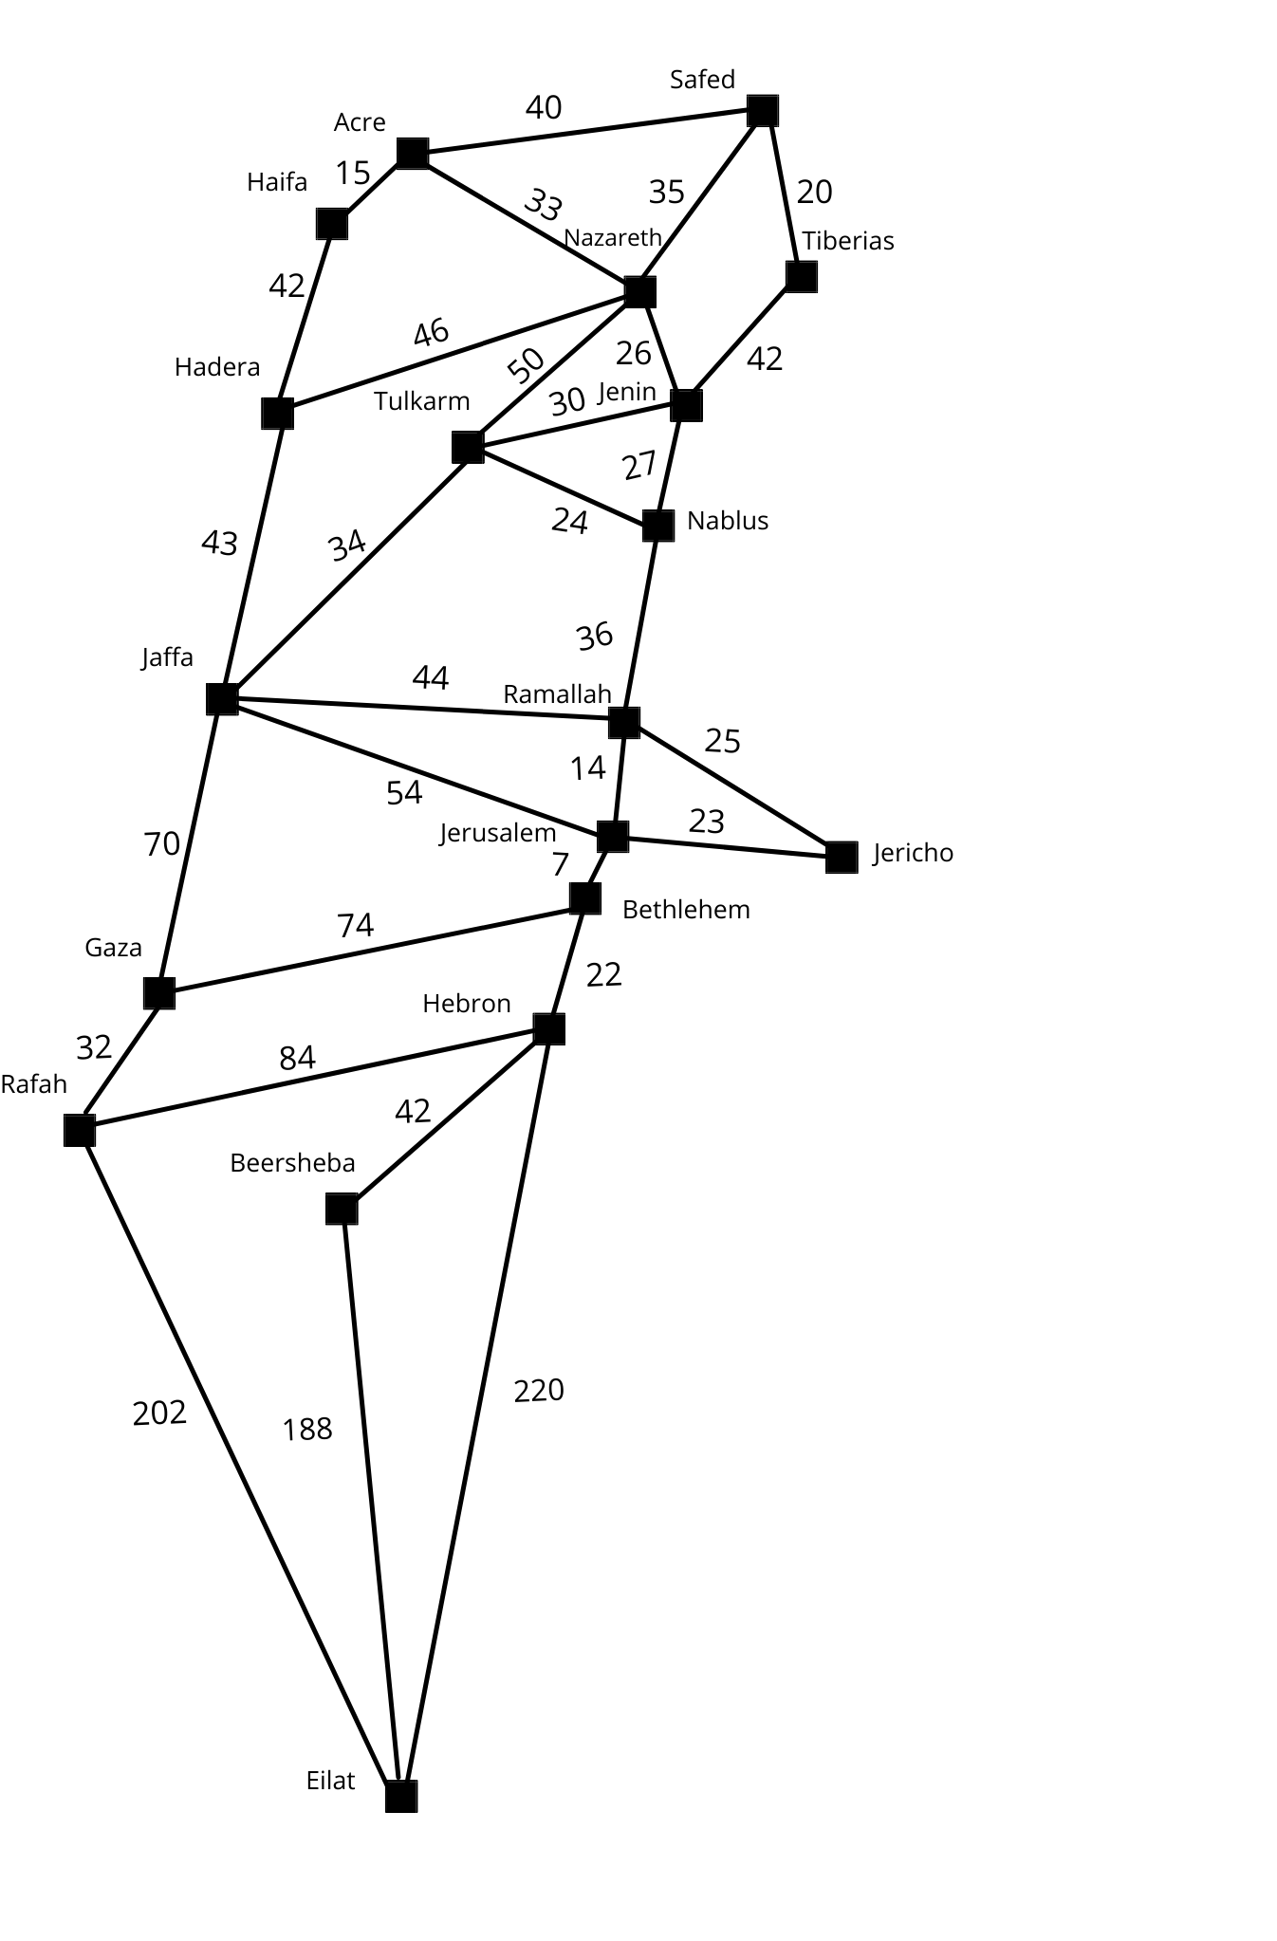
BEST-FIRST SEARCH (BEST-FS)
• The search space is evaluated according to a heuristic function.
• Nodes yet to be evaluated are kept on an OPEN list(represented as a priority queue)
• Nodes that have already been evaluated are stored on a CLOSED list.
• The OPEN list is then built in order of f(n).
This makes best-first search fundamentally greedy because it always chooses the best local opportunity in the search frontier.
dr. Mohamed Khalil
Palestine Technical University

Slide 2
Frontier
• Best-first search
• Idea: use an evaluation function f(n) for each node
• f(n) provides an estimate for the total cost.
• Expand the node n with smallest f(n).
• Implementation: Order the nodes in fringe increasing order of cost.
• Special cases:
• greedy best-first search
• A* search
dr. Mohamed Khalil
Palestine Technical University

Slide 3
Frontier
• The search frontier is defined as the set of node opportunities that can be searched next.
• In Best-First search, the frontier is a priority queue sorted in f(n) order.
• Given the strict order of f(n), the selection of the node to evaluate from the priority queue is greedy
dr. Mohamed Khalil
Palestine Technical University

Slide 4
Properties of best-first search
• Complete? No – can get stuck in loops.
• Time? O(b^{m}), but a good heuristic can give dramatic improvement
• Space? O(b^{m}) -- keeps all nodes in memory
• Optimal? No
a solution can be found in a longer path (higher h(n) with a lower g(n) value.
dr. Mohamed Khalil
Palestine Technical University

Slide 5
Palestine with step costs in km
Straight-line Distance to Eilat
Safed | 382
Eilat | 0
Acre | 375
Nazareth | 351
Tiberias | 364
Tulkarm | 307
Haifa | 360
Hadera | 320
Nablus | 298
Ramallah | 262
Jerusalem | 247
Bethlehem | 240
Jericho | 260
Jenin | 325
Jaffa | 278
Hebron | 220
Rafah | 202
Gaza | 222
Beersheba | 189
dr. Mohamed Khalil
Palestine Technical University

Slide 6
Best-first search
• Evaluation function f(n) = h(n) (heuristic)
= estimate of cost from n to goal
• e.g., h_{SLD}(n) = straight-line distance from n to Bucharest
• Greedy best-first search expands the node that appears to be closest to goal
dr. Mohamed Khalil
Palestine Technical University

Slide 7
Greedy Best-first search example
Safed
382
Straight-line Distance to Eilat
Safed | 382
Eilat | 0
Acre | 375
Nazareth | 351
Tiberias | 364
Tulkarm | 307
Haifa | 360
Hadera | 320
Nablus | 298
Ramallah | 262
Jerusalem | 247
Bethlehem | 240
Jericho | 260
Jenin | 325
Jaffa | 278
Hebron | 220
Rafah | 202
Gaza | 222
Beersheba | 189
dr. Mohamed Khalil
Palestine Technical University

Slide 8
Greedy Best-first search example
Safed
382
Straight-line Distance to Eilat
Acre
Nazareth
Tiberias
Safed | 382
Eilat | 0
Acre | 375
Nazareth | 351
Tiberias | 364
Tulkarm | 307
Haifa | 360
Hadera | 320
Nablus | 298
Ramallah | 262
Jerusalem | 247
Bethlehem | 240
Jericho | 260
Jenin | 325
Jaffa | 278
Hebron | 220
Rafah | 202
Gaza | 222
Beersheba | 189
375
351
364
dr. Mohamed Khalil
Palestine Technical University

Slide 9
Greedy Best-first search example
Safed
382
Straight-line Distance to Eilat
Acre
Nazareth
Tiberias
Safed | 382
Eilat | 0
Acre | 375
Nazareth | 351
Tiberias | 364
Tulkarm | 307
Haifa | 360
Hadera | 320
Nablus | 298
Ramallah | 262
Jerusalem | 247
Bethlehem | 240
Jericho | 260
Jenin | 325
Jaffa | 278
Hebron | 220
Rafah | 202
Gaza | 222
Beersheba | 189
375
351
364
Tulkarm
Hadera
Safed
Jenin
Acre
Haifa
307
320
382
325
375
360
dr. Mohamed Khalil
Palestine Technical University

Slide 10
Greedy Best-first search example
Safed
382
Straight-line Distance to Eilat
Acre
Nazareth
Tiberias
Safed | 382
Eilat | 0
Acre | 375
Nazareth | 351
Tiberias | 364
Tulkarm | 307
Haifa | 360
Hadera | 320
Nablus | 298
Ramallah | 262
Jerusalem | 247
Bethlehem | 240
Jericho | 260
Jenin | 325
Jaffa | 278
Hebron | 220
Rafah | 202
Gaza | 222
Beersheba | 189
375
351
364
Tulkarm
Hadera
Safed
Jenin
Acre
Haifa
307
320
382
325
375
360
Nablus
Jaffa
Jenin
Nazareth
298
278
320
351
dr. Mohamed Khalil
Palestine Technical University

Slide 11
Greedy Best-first search example
Safed
382
Straight-line Distance to Eilat
Acre
Nazareth
Tiberias
Safed | 382
Eilat | 0
Acre | 375
Nazareth | 351
Tiberias | 364
Tulkarm | 307
Haifa | 360
Hadera | 320
Nablus | 298
Ramallah | 262
Jerusalem | 247
Bethlehem | 240
Jericho | 260
Jenin | 325
Jaffa | 278
Hebron | 220
Rafah | 202
Gaza | 222
Beersheba | 189
375
351
364
Tulkarm
Hadera
Safed
Jenin
Acre
Haifa
307
320
382
325
375
360
Nablus
Jaffa
Jenin
Nazareth
298
278
320
351
Jerusalem
Gaza
Ramallah
Hadera
Tulkarm
247
222
262
320
307
dr. Mohamed Khalil
Palestine Technical University

Slide 12
Greedy Best-first search example
Safed
Straight-line Distance to Eilat
Acre
Nazareth
Tiberias
Safed | 382
Eilat | 0
Acre | 375
Nazareth | 351
Tiberias | 364
Tulkarm | 307
Haifa | 360
Hadera | 320
Nablus | 298
Ramallah | 262
Jerusalem | 247
Bethlehem | 240
Jericho | 260
Jenin | 325
Jaffa | 278
Hebron | 220
Rafah | 202
Gaza | 222
Beersheba | 189
375
364
Tulkarm
Hadera
Safed
Jenin
Acre
Haifa
320
382
325
375
360
Nablus
Jaffa
Jenin
Nazareth
298
320
351
Jerusalem
Gaza
Ramallah
Hadera
Tulkarm
247
262
320
307
Rafah
Bethlehem
Jaffa
202
240
278
dr. Mohamed Khalil
Palestine Technical University

Slide 13
Greedy Best-first search example
Safed
Straight-line Distance to Eilat
Acre
Nazareth
Tiberias
Safed | 382
Eilat | 0
Acre | 375
Nazareth | 351
Tiberias | 364
Tulkarm | 307
Haifa | 360
Hadera | 320
Nablus | 298
Ramallah | 262
Jerusalem | 247
Bethlehem | 240
Jericho | 260
Jenin | 325
Jaffa | 278
Hebron | 220
Rafah | 202
Gaza | 222
Beersheba | 189
375
364
Tulkarm
Hadera
Safed
Jenin
Acre
Haifa
320
382
325
375
360
Nablus
Jaffa
Jenin
Nazareth
298
320
351
Jerusalem
Gaza
Ramallah
Hadera
Tulkarm
247
262
320
307
Rafah
Bethlehem
Jaffa
240
278
Eilat
Gaza
Hebron
0
222
220
dr. Mohamed Khalil
Palestine Technical University

Slide 15
A * search
• Idea: avoid expanding paths that are already expensive
• Evaluation function f(n) = g(n) + h(n)
• g(n) = cost so far to reach n
• h(n) = estimated cost from n to goal
• f(n) = estimated total cost of path through n to goal
dr. Mohamed Khalil
Palestine Technical University

Slide 16
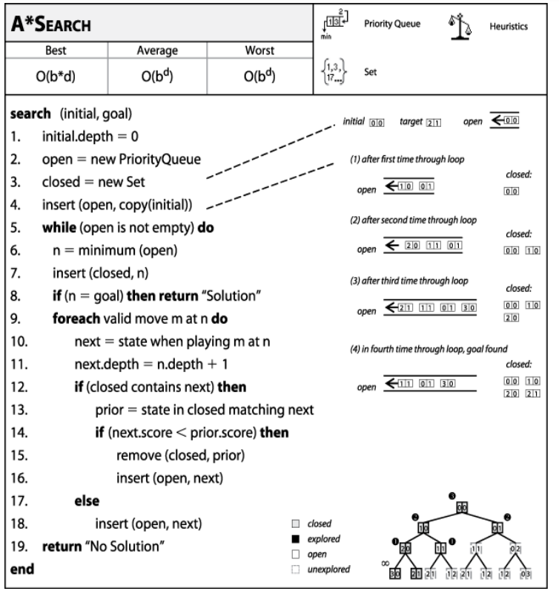

Slide 17
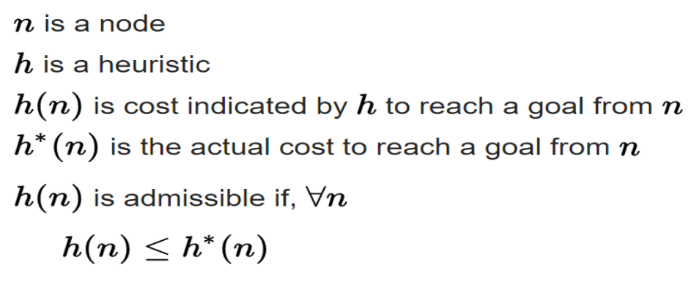
Admissible heuristic
• a heuristic function is said to be admissible if it never overestimates the cost of reaching the goal, i.e. the cost it estimates to reach the goal is not higher than the lowest possible cost from the current point in the path.
dr. Mohamed Khalil
Palestine Technical University

Slide 18
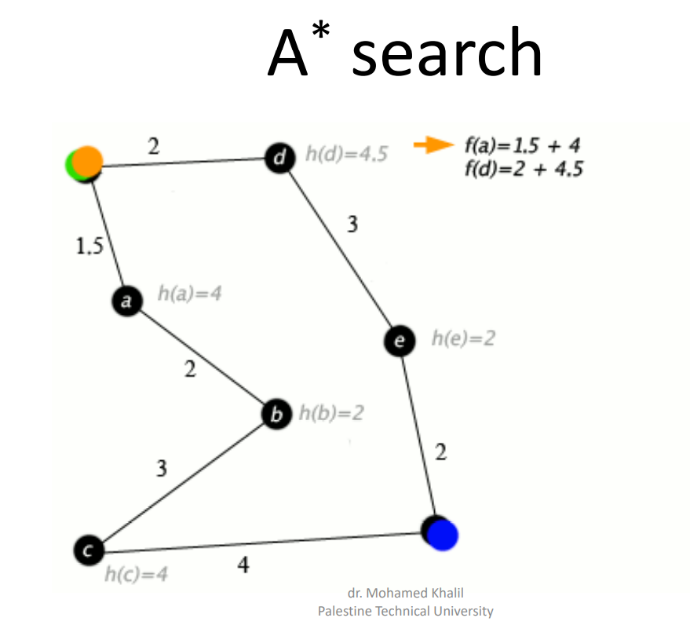

Slide 19
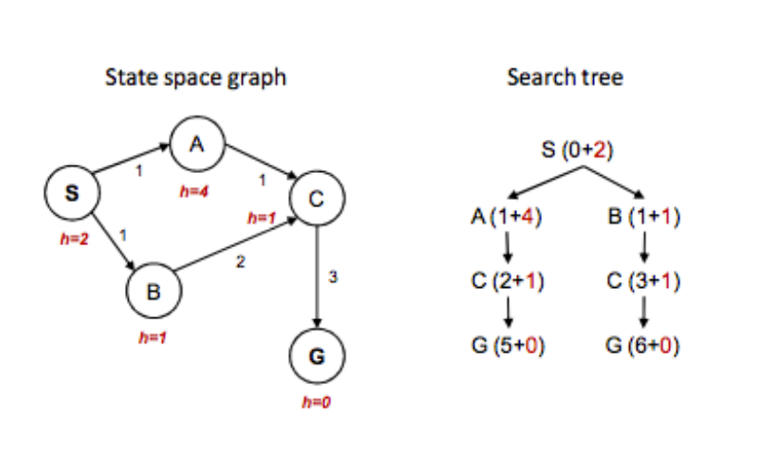
A * search
dr. Mohamed Khalil
Palestine Technical University

Slide 20
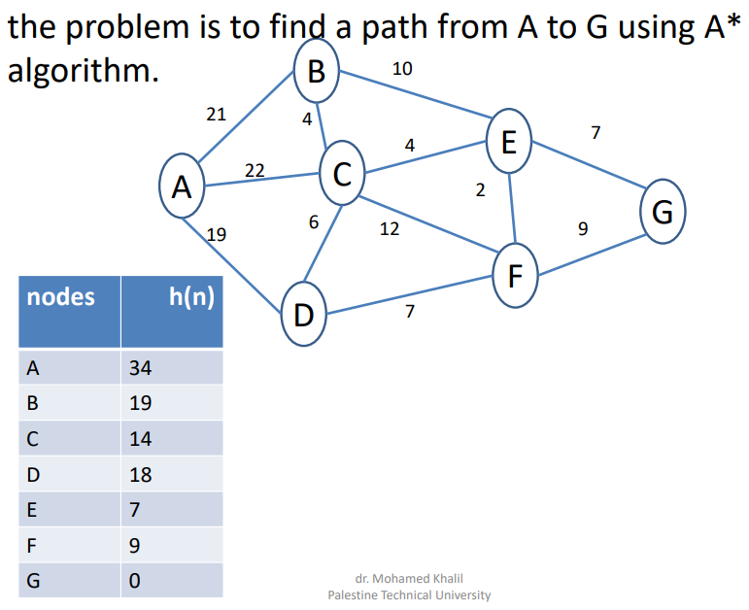
dr. Mohamed Khalil
Palestine Technical University

Slide 21
Palestine with step costs in km
Straight-line Distance to Eilat
Safed | 382
Eilat | 0
Acre | 375
Nazareth | 351
Tiberias | 364
Tulkarm | 307
Haifa | 360
Hadera | 320
Nablus | 298
Ramallah | 262
Jerusalem | 247
Bethlehem | 240
Jericho | 260
Jenin | 325
Jaffa | 278
Hebron | 220
Rafah | 202
Gaza | 222
Beersheba | 189
dr. Mohamed Khalil
Palestine Technical University

Slide 22
A * search Example
Open List: Safed
Straight-line Distance to Eilat
Safed | 382
Eilat | 0
Acre | 375
Nazareth | 351
Tiberias | 364
Tulkarm | 307
Haifa | 360
Hadera | 320
Nablus | 298
Ramallah | 262
Jerusalem | 247
Bethlehem | 240
Jericho | 260
Jenin | 325
Jaffa | 278
Hebron | 220
Rafah | 202
Gaza | 222
Beersheba | 189
Safed
0+382=382
We start with our initial state Safed.
We make a node and add it to the open list. Since it’s the only thing on the open list,
we expand the node. Think of the open list as a priority queue (or heap) that sorts the nodes inside of it according to their g()+h() score
dr. Mohamed Khalil
Palestine Technical University

Slide 23
A * search Example
Straight-line Distance to Eilat
Open List:
Tiberias
Nazareth
Acre
Safed | 382
Eilat | 0
Acre | 375
Nazareth | 351
Tiberias | 364
Tulkarm | 307
Haifa | 360
Hadera | 320
Nablus | 298
Ramallah | 262
Jerusalem | 247
Bethlehem | 240
Jericho | 260
Jenin | 325
Jaffa | 278
Hebron | 220
Rafah | 202
Gaza | 222
Beersheba | 189
Safed
Acre
Nazareth
Tiberias
40+375=415
35+351=386
20+364=384
We add the three nodes we found to the open list. We sort them according to the g()+h() calculation.
dr. Mohamed Khalil
Palestine Technical University

Slide 24
A * search Example
Open List:
Nazareth
Jenin
Acre
Safed
Acre
Nazareth
Tiberias
40+375=415
35+351=386
Jenin
Safed
62+325=387
40+382=422
When we expand Tiberias, we run into Safed again. But we’ve already expanded this node once; so, we don’t add it to the open list again.
We see that Nazareth is at the top of the open list; so, it’s the next node we will expand.
dr. Mohamed Khalil
Palestine Technical University

Slide 25
A * search Example
Straight-line Distance to Eilat
Open List:
Jenin
Tulkarm
Hadera
Acre
Safed | 382
Eilat | 0
Acre | 375
Nazareth | 351
Tiberias | 364
Tulkarm | 307
Haifa | 360
Hadera | 320
Nablus | 298
Ramallah | 262
Jerusalem | 247
Bethlehem | 240
Jericho | 260
Jenin | 325
Jaffa | 278
Hebron | 220
Rafah | 202
Gaza | 222
Beersheba | 189
Safed
Acre
Nazareth
Tiberias
40+375=415
Acre
Safed
Hadera
Tulkarm
Jenin
Jenin
Safed
68+375=443
70+382=452
81+320=401
85+307=392
61+325=386
62+325=387
40+382=422
When we expand Nazareth, we run into Acre and Safed again. But we’ve already expanded those nodes once; so, we don’t add it to the open list again.
dr. Mohamed Khalil
Palestine Technical University

Slide 26
A * search Example
Straight-line Distance to Eilat
Open List:
Nablus
Tulkarm
Hadera
Acre
Safed | 382
Eilat | 0
Acre | 375
Nazareth | 351
Tiberias | 364
Tulkarm | 307
Haifa | 360
Hadera | 320
Nablus | 298
Ramallah | 262
Jerusalem | 247
Bethlehem | 240
Jericho | 260
Jenin | 325
Jaffa | 278
Hebron | 220
Rafah | 202
Gaza | 222
Beersheba | 189
Safed
Acre
Nazareth
Tiberias
40+375=415
Acre
Safed
Hadera
Tulkarm
Jenin
Jenin
Safed
68+375=443
70+382=452
81+320=401
85+307=392
62+325=387
40+382=422
Tiberias
Nazareth
Nablus
Tulkarm
103+364=467
87+351=438
88+298=386
91+307=398
When we expand Jenin, we run into Nazareth and Tiberias again.
But we’ve already expanded those nodes once; so, we don’t add them to the open list again.
Nablus will be the next node we should expand – it’s at the top of the sorted open list.
dr. Mohamed Khalil
Palestine Technical University

Slide 27
A * search Example
Open List:
Ramallah
Tulkarm
Hadera
Acre
Straight-line Distance to Eilat
Safed | 382
Eilat | 0
Acre | 375
Nazareth | 351
Tiberias | 364
Tulkarm | 307
Haifa | 360
Hadera | 320
Nablus | 298
Ramallah | 262
Jerusalem | 247
Bethlehem | 240
Jericho | 260
Jenin | 325
Jaffa | 278
Hebron | 220
Rafah | 202
Gaza | 222
Beersheba | 189
Safed
Acre
Nazareth
Tiberias
40+375=415
Acre
Safed
Hadera
Tulkarm
Jenin
Jenin
Safed
68+375=443
70+382=452
81+320=401
85+307=392
62+325=387
40+382=422
Tiberias
Nazareth
Nablus
Tulkarm
103+364=467
87+351=438
91+307=398
Tulkarm
Ramallah
Jenin
112+307=419
124+262=386
115+325=440
When we expand Nablus, we run into Tulkarm and Jenin again.
But we’ve already expanded Jenin node once; so, we don’t add it to the open list again
Tulkarm Remains in it's old location in the open list
Ramallah will be the next node we should expand – it’s at the top of the sorted open list.
dr. Mohamed Khalil
Palestine Technical University

Slide 28
A * search Example
Straight-line Distance to Eilat
Open List:
Jerusalem
Tulkarm
Jericho
Hadera
Acre
Jaffa
Safed | 382
Eilat | 0
Acre | 375
Nazareth | 351
Tiberias | 364
Tulkarm | 307
Haifa | 360
Hadera | 320
Nablus | 298
Ramallah | 262
Jerusalem | 247
Bethlehem | 240
Jericho | 260
Jenin | 325
Jaffa | 278
Hebron | 220
Rafah | 202
Gaza | 222
Beersheba | 189
Safed
Acre
Nazareth
Tiberias
40+375=415
Acre
Safed
Hadera
Tulkarm
Jenin
Jenin
Safed
68+375=443
70+382=452
81+320=401
85+307=392
62+325=387
40+382=422
Tiberias
Nazareth
Nablus
Tulkarm
103+364=467
87+351=438
91+307=398
Tulkarm
Ramallah
Jenin
112+307=419
115+325=440
Jaffa
Nablus
Jericho
Jerusalem
168+278=446
160+307=467
133+260=393
138+247=385
Next We Expand Jerusalem It has the lowest f(n) (top of the open list)
dr. Mohamed Khalil
Palestine Technical University

Slide 29
A * search Example
Straight-line Distance to Eilat
Open List:
Bethlehem
Tulkarm
Jericho
Hadera
Acre
Jaffa
Safed | 382
Eilat | 0
Acre | 375
Nazareth | 351
Tiberias | 364
Tulkarm | 307
Haifa | 360
Hadera | 320
Nablus | 298
Ramallah | 262
Jerusalem | 247
Bethlehem | 240
Jericho | 260
Jenin | 325
Jaffa | 278
Hebron | 220
Rafah | 202
Gaza | 222
Beersheba | 189
Safed
Acre
Nazareth
Tiberias
40+375=415
Acre
Safed
Hadera
Tulkarm
Jenin
Jenin
Safed
68+375=443
70+382=452
81+320=401
85+307=392
62+325=387
40+382=422
Tiberias
Nazareth
Nablus
Tulkarm
103+364=467
87+351=438
91+307=398
Tulkarm
Ramallah
Jenin
112+307=419
115+325=440
Jaffa
Nablus
Jericho
Jerusalem
168+278=446
160+307=467
133+260=393
138+247=385
Jericho
Ramallah
Jaffa
Bethlehem
Next We Expand Bethlehem top of the open list
We run into Ramallah ,Jericho , Jaffa again
We don't add them again to the list
161+260=421
152+262=414
192+278=470
145+240=385
dr. Mohamed Khalil
Palestine Technical University

Slide 30
A * search Example
Open List:
Hebron
Tulkarm
Jericho
Hadera
Gaza
Acre
Jaffa
Straight-line Distance to Eilat
Safed | 382
Eilat | 0
Acre | 375
Nazareth | 351
Tiberias | 364
Tulkarm | 307
Haifa | 360
Hadera | 320
Nablus | 298
Ramallah | 262
Jerusalem | 247
Bethlehem | 240
Jericho | 260
Jenin | 325
Jaffa | 278
Hebron | 220
Rafah | 202
Gaza | 222
Beersheba | 189
Safed
Acre
Nazareth
Tiberias
40+375=415
Acre
Safed
Hadera
Tulkarm
Jenin
Jenin
Safed
68+375=443
70+382=452
81+320=401
85+307=392
62+325=387
40+382=422
Tiberias
Nazareth
Nablus
Tulkarm
103+364=467
87+351=438
91+307=398
Tulkarm
Ramallah
Jenin
112+307=419
115+325=440
Jaffa
Nablus
Jericho
Jerusalem
168+278=446
160+307=467
133+260=393
138+247=385
Jericho
Ramallah
Jaffa
Bethlehem
Next We Expand Hebron top of the open list
we’ve already expanded Jerusalem node once; so, we don’t add it to the open list again
161+260=421
152+262=414
192+278=470
Jerusalem
Gaza
Hebron
152+247=399
219+222=441
167+220=387
dr. Mohamed Khalil
Palestine Technical University

Slide 31
A * search Example
Open List:
Eilat
Tulkarm
Jericho
Beersheba
Hadera
Gaza
Acre
Jaffa
Straight-line Distance to Eilat
Safed | 382
Eilat | 0
Acre | 375
Nazareth | 351
Tiberias | 364
Tulkarm | 307
Haifa | 360
Hadera | 320
Nablus | 298
Ramallah | 262
Jerusalem | 247
Bethlehem | 240
Jericho | 260
Jenin | 325
Jaffa | 278
Hebron | 220
Rafah | 202
Gaza | 222
Beersheba | 189
Safed
Acre
Nazareth
Tiberias
40+375=415
Acre
Safed
Hadera
Tulkarm
Jenin
Jenin
Safed
68+375=443
70+382=452
81+320=401
85+307=392
62+325=387
40+382=422
Tiberias
Nazareth
Nablus
Tulkarm
103+364=467
87+351=438
91+307=398
Tulkarm
Ramallah
Jenin
112+307=419
115+325=440
Jaffa
Nablus
Jericho
Jerusalem
168+278=446
160+307=467
133+260=393
138+247=385
Jericho
Ramallah
Jaffa
Bethlehem
We just found a better value for Eilat; so, it got moved higher in the list. We also found a worse value for Gaza – we just ignore this. And of course, we ran into Bethlehem again. Since it’s already been expanded once, we don’t re-add it to the Open List.
161+260=421
152+262=414
192+278=470
Jerusalem
Gaza
Hebron
152+247=399
219+222=441
Bethlehem
Rafah
Beersheba
Eilat
189+240=429
251+202=453
189+209=398
0+220=220
dr. Mohamed Khalil
Palestine Technical University

Slide 32
A * search Example
Open List:
Eilat
Tulkarm
Jericho
Beersheba
Hadera
Gaza
Acre
Jaffa
Straight-line Distance to Eilat
Safed | 382
Eilat | 0
Acre | 375
Nazareth | 351
Tiberias | 364
Tulkarm | 307
Haifa | 360
Hadera | 320
Nablus | 298
Ramallah | 262
Jerusalem | 247
Bethlehem | 240
Jericho | 260
Jenin | 325
Jaffa | 278
Hebron | 220
Rafah | 202
Gaza | 222
Beersheba | 189
Safed
Acre
Nazareth
Tiberias
40+375=415
Acre
Safed
Hadera
Tulkarm
Jenin
Jenin
Safed
68+375=443
70+382=452
81+320=401
85+307=392
62+325=387
40+382=422
Tiberias
Nazareth
Nablus
Tulkarm
103+364=467
87+351=438
91+307=398
Tulkarm
Ramallah
Jenin
112+307=419
115+325=440
Jaffa
Nablus
Jericho
Jerusalem
168+278=446
160+307=467
133+260=393
138+247=385
Jericho
Ramallah
Jaffa
Bethlehem
161+260=421
152+262=414
192+278=470
Now it looks like Eilat is at the top of the open list…
Now we “expand” the node for Eilat . We’re done!
(And we know the path that we’ve found is optimal.)
Jerusalem
Gaza
Hebron
152+247=399
219+222=441
Bethlehem
Rafah
Beersheba
Eilat
189+240=429
251+202=453
189+209=398
0+220=220
dr. Mohamed Khalil
Palestine Technical University

Slide 33
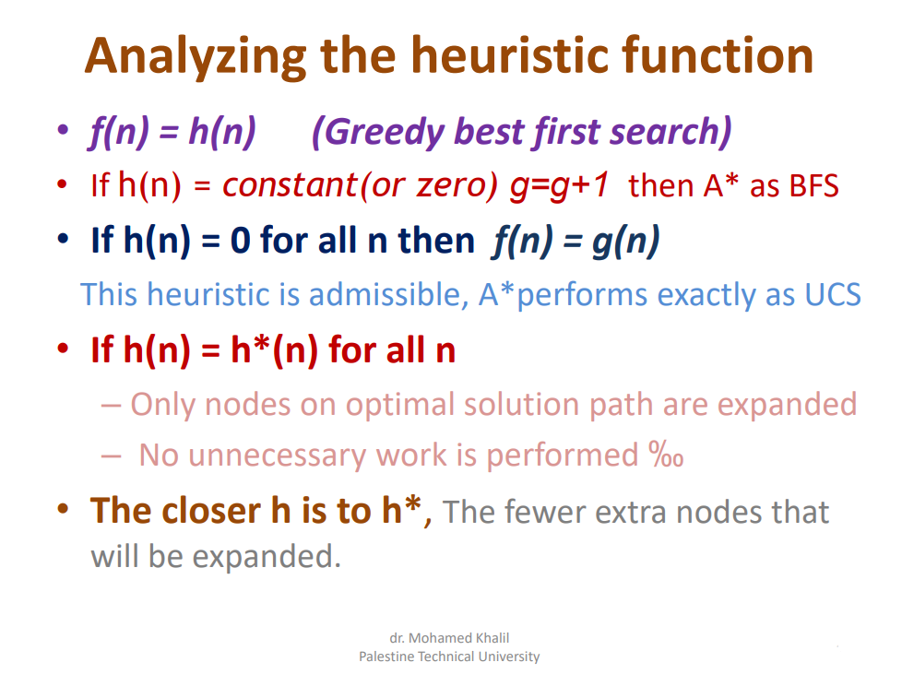

Slide 34
Properties of Best First Search(A*)
• Complete? Yes – as long as the memory supports the depth and branching factor of the tree.
• Time? O(b^{d}), but a good heuristic can give dramatic improvement.
• Space? O(b^{d}) -- keeps all nodes in memory.
• Optimal? Yes
If h is admissible, A* will always find a least cost path to the goal
dr. Mohamed Khalil
Palestine Technical University

Slide 35
Resources
Distance to
Wikipedia
Utc.city
Google Maps
Palestinian Cities in Arabic
Acre-عكا
Eilat - ام الرشراش
Nablus - نابلس
Jenin - جنين
Tulakrm - طولكرم
Jerusalem - القدس
Safed - صفد
Haifa - حيفا
Tiberias - طبريا
Hadera - الخضيرة
Nazareth - الناصرة
Jaffa - يافا
Hebron - الخليل
Ramallah - رام الله
Jericho - أريحا
Bethlehem - بيت لحم
Gaza - غزة
Beersheba - بئر السبع
Rafah - رفح
By . Asad Asad

